Slide 1

2018
项目简介
中国北京.四牛科技公司

Slide 2
公司简介
四牛科技有限公司，是综合性教育集团，同时也是教育培训集团。公司业务包括IT培训、外语培训、中小学基础教育、学前教育、在线教育、出国咨询、图书出版等各个领域。旗下还有优能中学教育、泡泡少儿教育、前途出国咨询、迅程在线教育、大愚文化出版、满天星亲子教育、同文高考复读等子品牌。公司于2006年在美国纽约证券交易所上市，是中国大陆第一家在美国上市的教育机构。

Slide 3
目录 / Contents
01
项目概述
02
网络搭建技术点详解
03
设备选购
04
总结

Slide 4
01
项目概述
Project Overview

Slide 5




1
教学办公网络整体概述/曹宇
Internet
R
SW1
DNS服务器
PXE服务器
SW2
SW3
SW4
教室
办公室
教学服务器

Slide 6
02
网络搭建技术点详解
Detailed Network Construction Technology

Slide 7
1
Vlan及网络构建 / 韩晋彪
vlan 是什么？
在计算机网络中，一个二层网络可以被划分为多个不同的广播域，一个广播域对应了一个特定的用户组，默认情况下这些不同的广播域是相互隔离的。不同的广播域之间想要通信，要通过一个或多个路由器。这样的一个广播域就称为VLAN

Slide 8
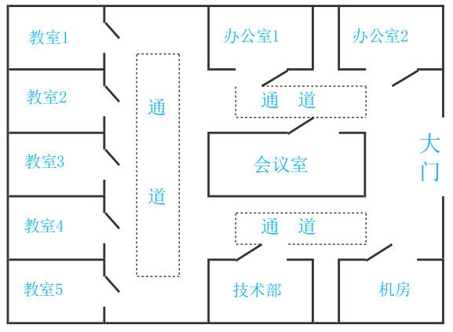
1
Vlan及网络构建 / 韩晋彪

Slide 9



1
Vlan及网络构建 / 韩晋彪
Vlan 有什么作用呢？
1.减小广播域
2.增加安全性
3.提高带宽利用率
4.降低延迟

Slide 10
1
Vlan及网络构建 / 韩晋彪
Internet
R
SW1
DNS服务器
PXE服务器
SW2
SW3
SW4
教室
办公室
教学服务器

Slide 11
1
Vlan及网络构建 / 韩晋彪
Internet
R
SW1
DNS服务器
PXE服务器
SW2
SW3
SW4
教室
办公室
教学服务器

Slide 12
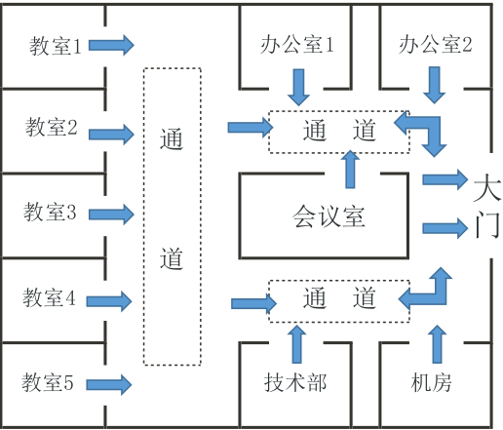

1
Vlan及网络构建 / 韩晋彪

Slide 13
1
Vlan及网络构建 / 韩晋彪
实 用 ！ ！ ！
省 钱 ！ ！ ！

Slide 14
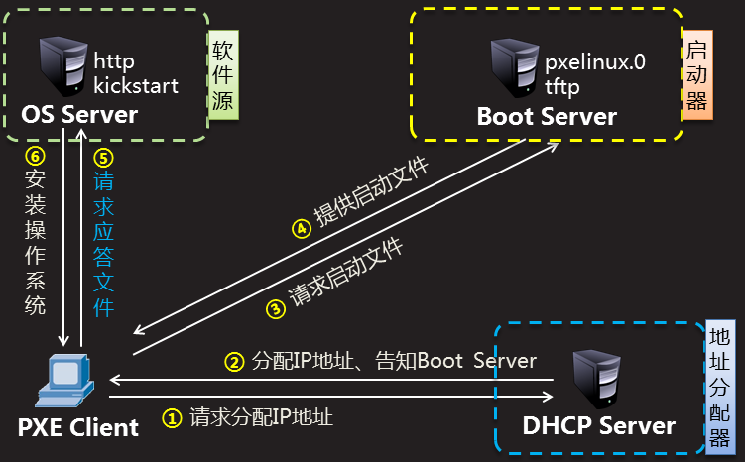
2
PXE / 贾歆宇
PXE网络装机
Pre-boot eXecution Environment
预启动执行环境，在操作系统之前运行
可用于远程安转

Slide 15
2
PXE / 贾歆宇
规模化
自动化
远程装机
PXE
同时装配多台主机
装系统，配置各种服务
不需要光盘、U盘等物理安装介质

Slide 16

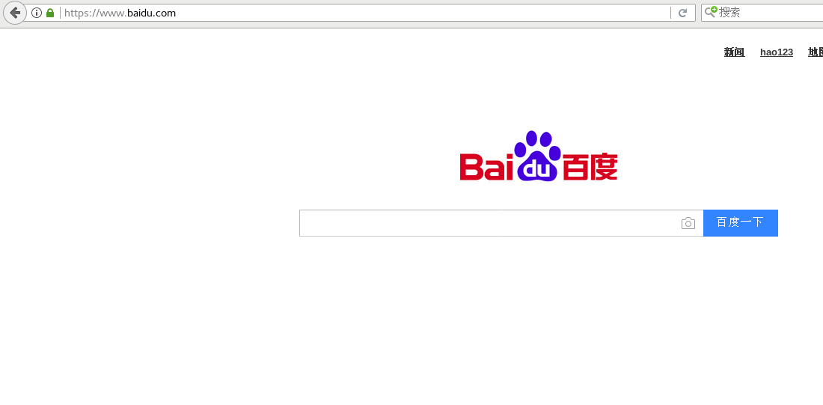

3
DNS服务器 / 边金猛
www.baidu.com
DNS服务器
119.75.247.109

Slide 17
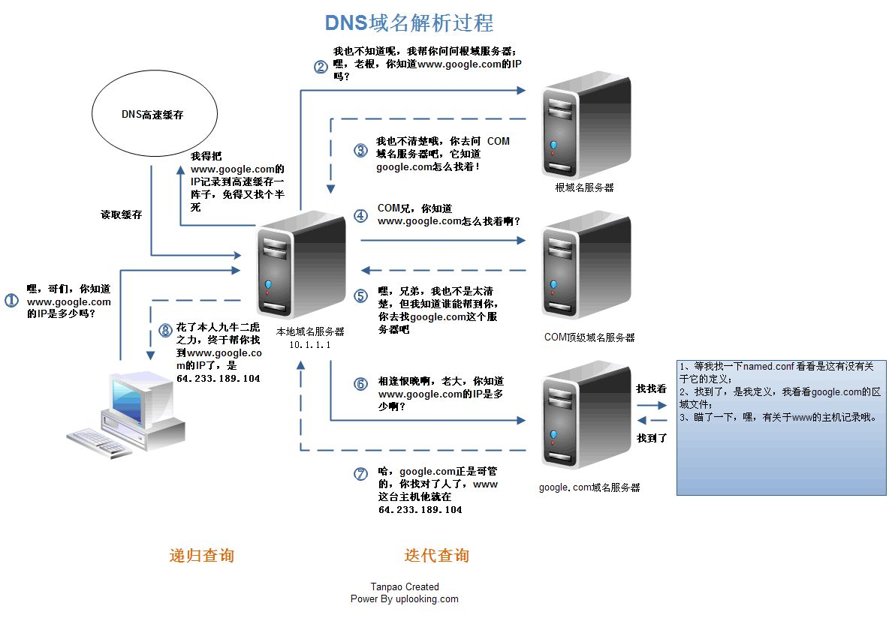
3
缓存DNS服务器 /边金猛

Slide 18
03
设备选购
Equipment Purchase

Slide 19
1
网络服务器和机架的选购 / 赵长江
服务器选购的条件
1.品牌
2.型号
3.价格

Slide 20
1
单击此处输入标题 / Click here to add your title
单击此处输入标题
I love you more than I've ever loved any woman. And I've waited longer for you than I've waited for any woman.
单击此处输入标题
I love you more than I've ever loved any woman. And I've waited longer for you than I've waited for any woman.
单击此处输入标题
I love you more than I've ever loved any woman. And I've waited longer for you than I've waited for any woman.
单击此处输入标题
I love you more than I've ever loved any woman. And I've waited longer for you than I've waited for any woman.

Slide 21
1
网络服务器和机架的选购 / 赵长江
网络设备
硬件设备 | 服务器 |  | 服务器机柜
品牌 | 戴尔 | 戴尔 | 大唐
类型型号 | R730 | R720 | A36042
价格 | 11000左右 | 10600左 右 | 2000
设备外形 | 机架式 | 机架式 | 机架式
内存容量/最大支持容量 | 8G/768G | 2G/768G
CPU核心数 | 四核 | 四核
硬盘容量 | 300GB | 1.2TB
设备大小 |  |  | 600*1000*2000

Slide 22
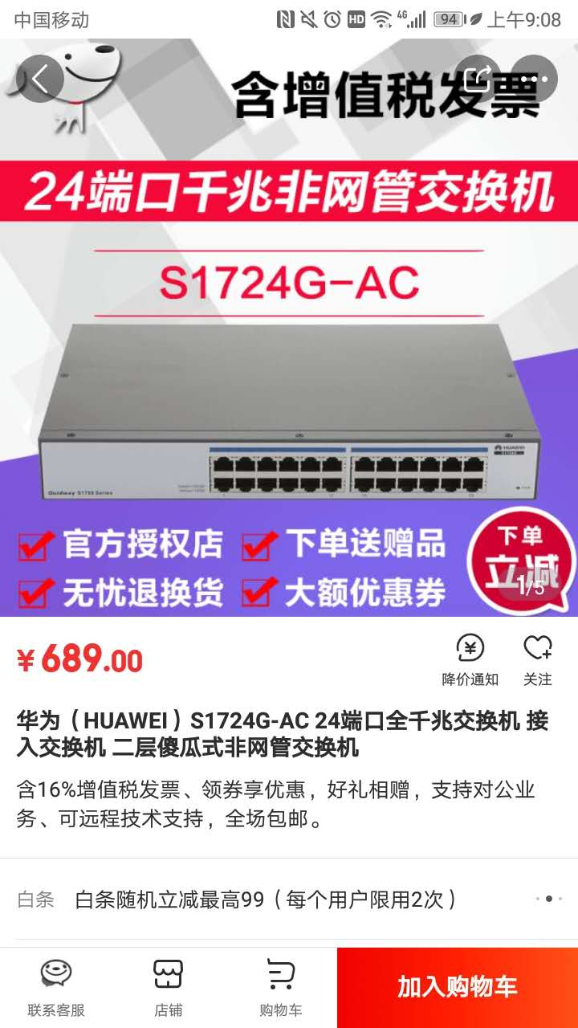
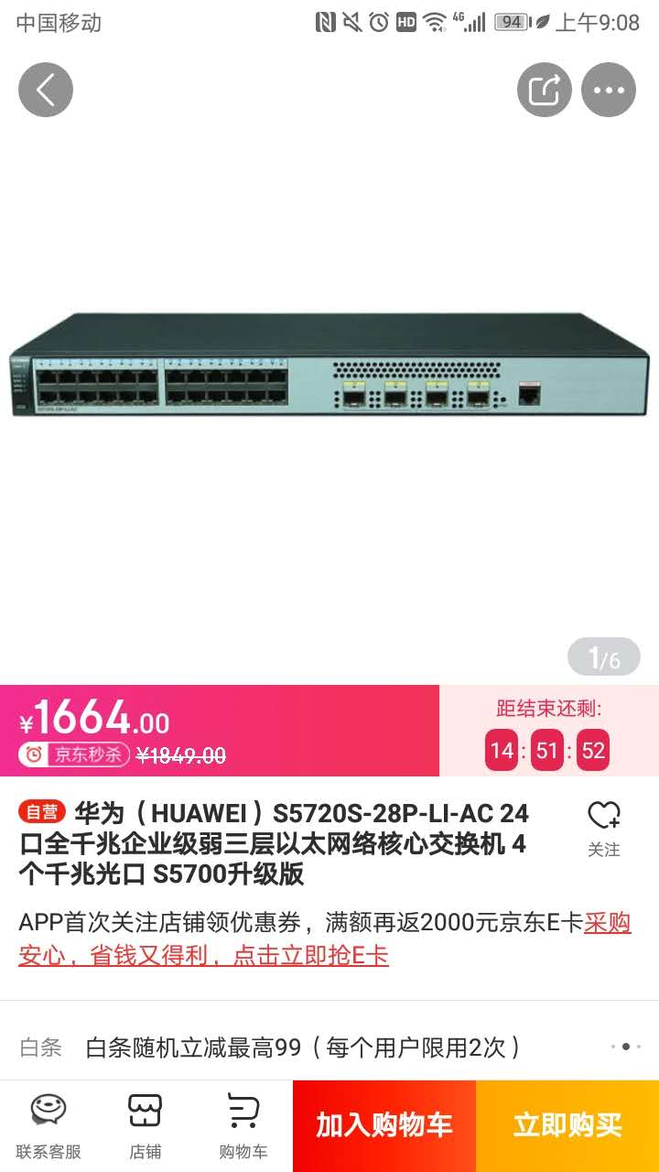
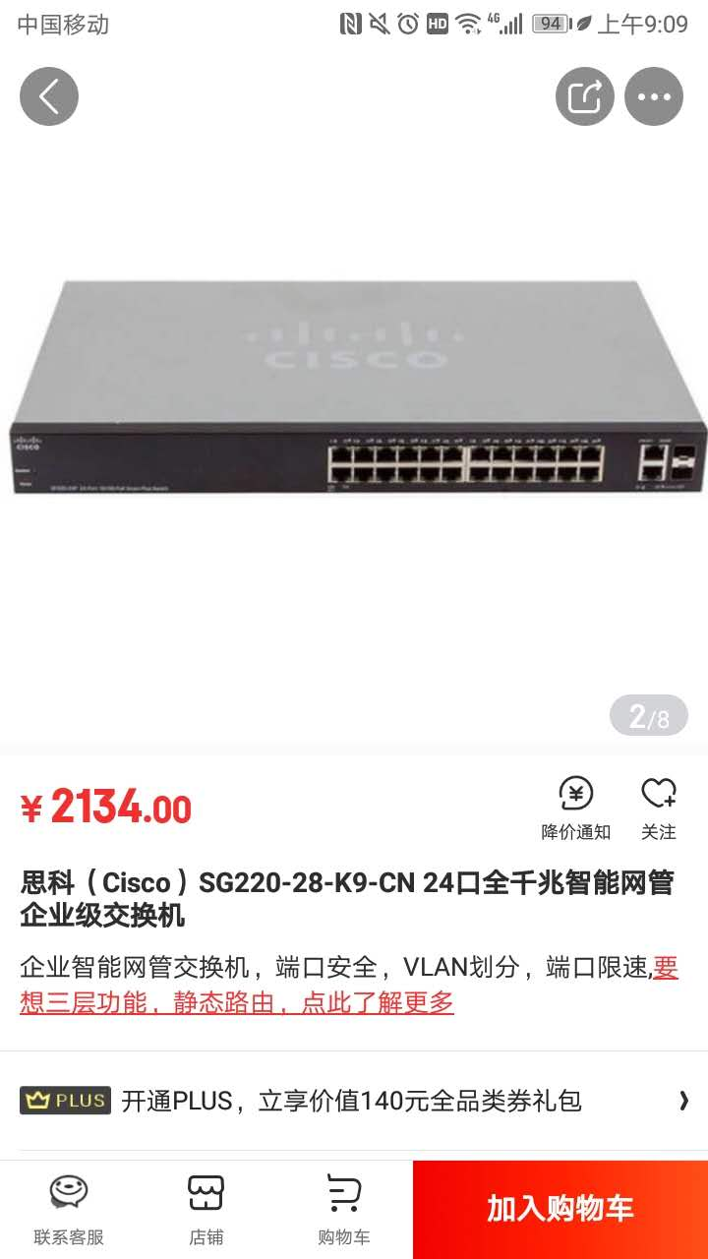
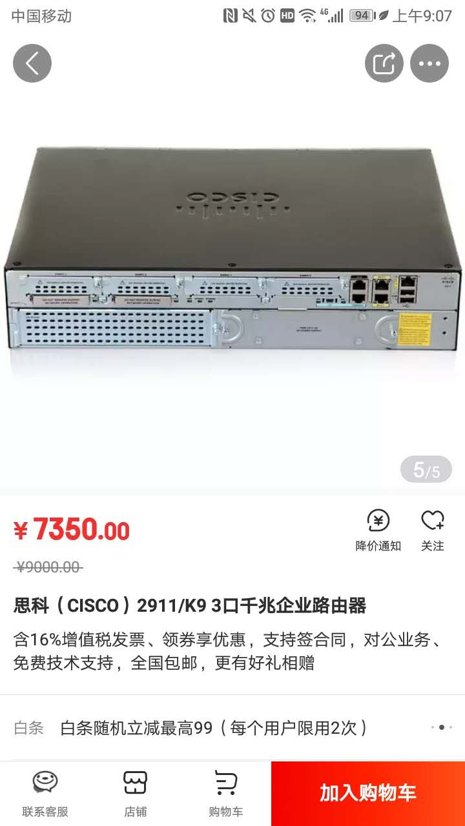
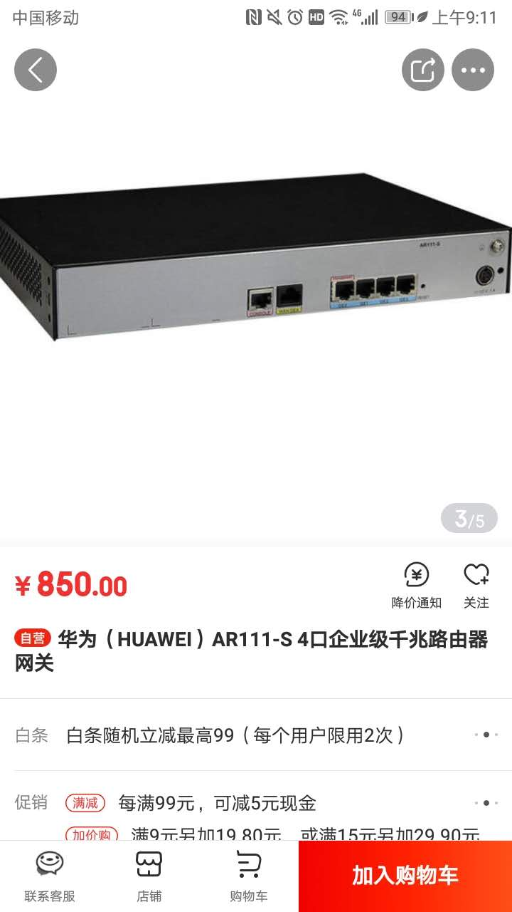
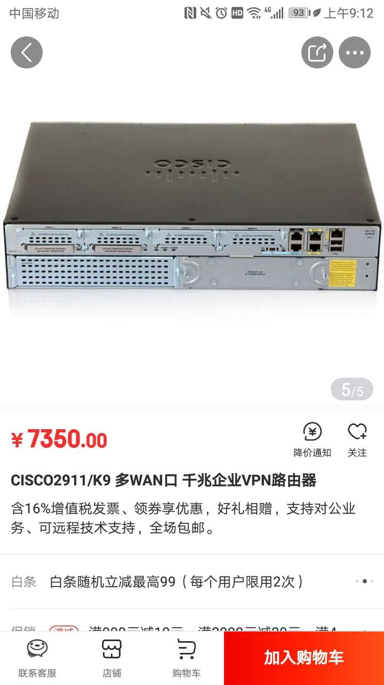
1
网络服务器和机架的选购 / 张雨楠
服务器选购的条件
1.品牌
2.型号
3.价格

Slide 23



1
单击此处输入标题 / Click here to add your title
单击此处输入标题
单击此处输入标题
I love you more than I've ever loved any woman. And I've waited longer for you than I've waited for any woman.
I love you more than I've ever loved any woman. And I've waited longer for you than I've waited for any woman.
单击此处输入标题
单击此处输入标题
I love you more than I've ever loved any woman. And I've waited longer for you than I've waited for any woman.
I love you more than I've ever loved any woman. And I've waited longer for you than I've waited for any woman.

Slide 24
1
单击此处输入标题 / Click here to add your title
85%
73%
78%
90%
单击此处输入标题
I love you more than I've ever loved any woman. And I've waited longer for you than I've waited for any woman.
单击此处输入标题
I love you more than I've ever loved any woman. And I've waited longer for you than I've waited for any woman.
单击此处输入标题
I love you more than I've ever loved any woman. And I've waited longer for you than I've waited for any woman.
单击此处输入标题
I love you more than I've ever loved any woman. And I've waited longer for you than I've waited for any woman.

Slide 25
1
单击此处输入标题 / Click here to add your title
单击此处输入标题
单击此处输入标题
I love you more than I've ever loved any woman. And I've waited longer for you than I've waited for any woman.
I love you more than I've ever loved any woman. And I've waited longer for you than I've waited for any woman.
单击此处输入标题
单击此处输入标题
I love you more than I've ever loved any woman. And I've waited longer for you than I've waited for any woman.
I love you more than I've ever loved any woman. And I've waited longer for you than I've waited for any woman.

Slide 26
1
单击此处输入标题 / Click here to add your title
单击此处输入标题
单击此处输入标题
I love you more than I've ever loved any woman. And I've waited longer for you than I've waited for any woman.
单击此处输入标题
I love you more than I've ever loved any woman. And I've waited longer for you than I've waited for any woman.
单击此处输入标题
I love you more than I've ever loved any woman. And I've waited longer for you than I've waited for any woman.

Slide 27
1
单击此处输入标题 / Click here to add your title
单击此处输入标题
单击此处输入标题
单击此处输入标题
单击此处输入标题
I love you more than I've ever loved any woman. And I've waited longer for you than I've waited for any woman.I love you more than I've ever loved any woman. And I've waited longer for you than I've waited for any woman.

Slide 28
1
单击此处输入标题 / Click here to add your title
单击此处输入标题
I love you more than I've ever loved any woman. And I've waited longer for you than I've waited for any woman.
单击此处输入标题
I love you more than I've ever loved any woman. And I've waited longer for you than I've waited for any woman.
单击此处输入标题
I love you more than I've ever loved any woman. And I've waited longer for you than I've waited for any woman.
单击此处输入标题
I love you more than I've ever loved any woman. And I've waited longer for you than I've waited for any woman.

Slide 29
04
总结
Summary

Slide 30
1
总结/ 国鸿麟
办公区域
公司内部网络的正常运行
教室
提供一个可控的教学局域网
服务器机房和网络机房
服务器机房：存放教学服务器、PXE、DNS服务器
网络机房：存放三层交换机、路由器等网络设备

Slide 31
1
总结/ 国鸿麟
OSPF/PAT
PXE
为办公区域和教室提供正常的因特网的访问
提供教室办公环境的批量自动安装
VLAN
DNS
提供良好的教学办公环境
缓存网址域名与IP地址，提高上网速度

Slide 32

1
单击此处输入标题 / Click here to add your title
单击此处输入标题
When a cigarette falls in love with a match,it is destined to be hurt.When a cigarette falls in love with a match,it is destined to be hurt.
When a cigarette falls in love with a match,it is destined to be hurt.When a cigarette falls in love with a match,it is destined to be hurt.When a cigarette falls in love with a match,it is destined to be hurt.When a cigarette falls in love with a match,it is destined to be hurt.

Slide 33
1
单击此处输入标题 / Click here to add your title
单击此处输入标题
I love you more than I've ever loved any woman. And I've waited longer for you than I've waited for any woman.
单击此处输入标题
I love you more than I've ever loved any woman. And I've waited longer for you than I've waited for any woman.
单击此处输入标题
I love you more than I've ever loved any woman. And I've waited longer for you than I've waited for any woman.

Slide 34
THANK YOU
汇报时间：2018年10月

